Slide 1
IoT internship
The project’s applicability, implementation & potentials ft. personal commentary
Presenters:
Luka Čubrilo / Intern

Slide 2
Use cases - providing context
Project structure
Arduino - Firmware
Raspberry Pi - Cloud client
PC - Cross-platform GUI App
Questions, discussion

Slide 3
Use cases - providing context

Slide 4
Use cases - providing context
Outdoors - Local weather measurements and forecast
You need your own measurements:
There are no well-known measurements nearby
You don’t trust the lizard people’s fake news
Maybe your surroundings are a pocket of different data

Slide 5
Use cases - providing context
Indoors - Monitoring and regulating a microclimate
Maybe you’re dealing with delicate processes:
Storing food, volatile substances, or otherwise sensitive materials
There is a VOC detector onboard!
Fermentation, dry aging, smoking, baking or other cooking processes
Growing sensitive crops, regulating their atmosphere
Scientific experiments, testing gas properties

Slide 6
Project structure

Slide 7
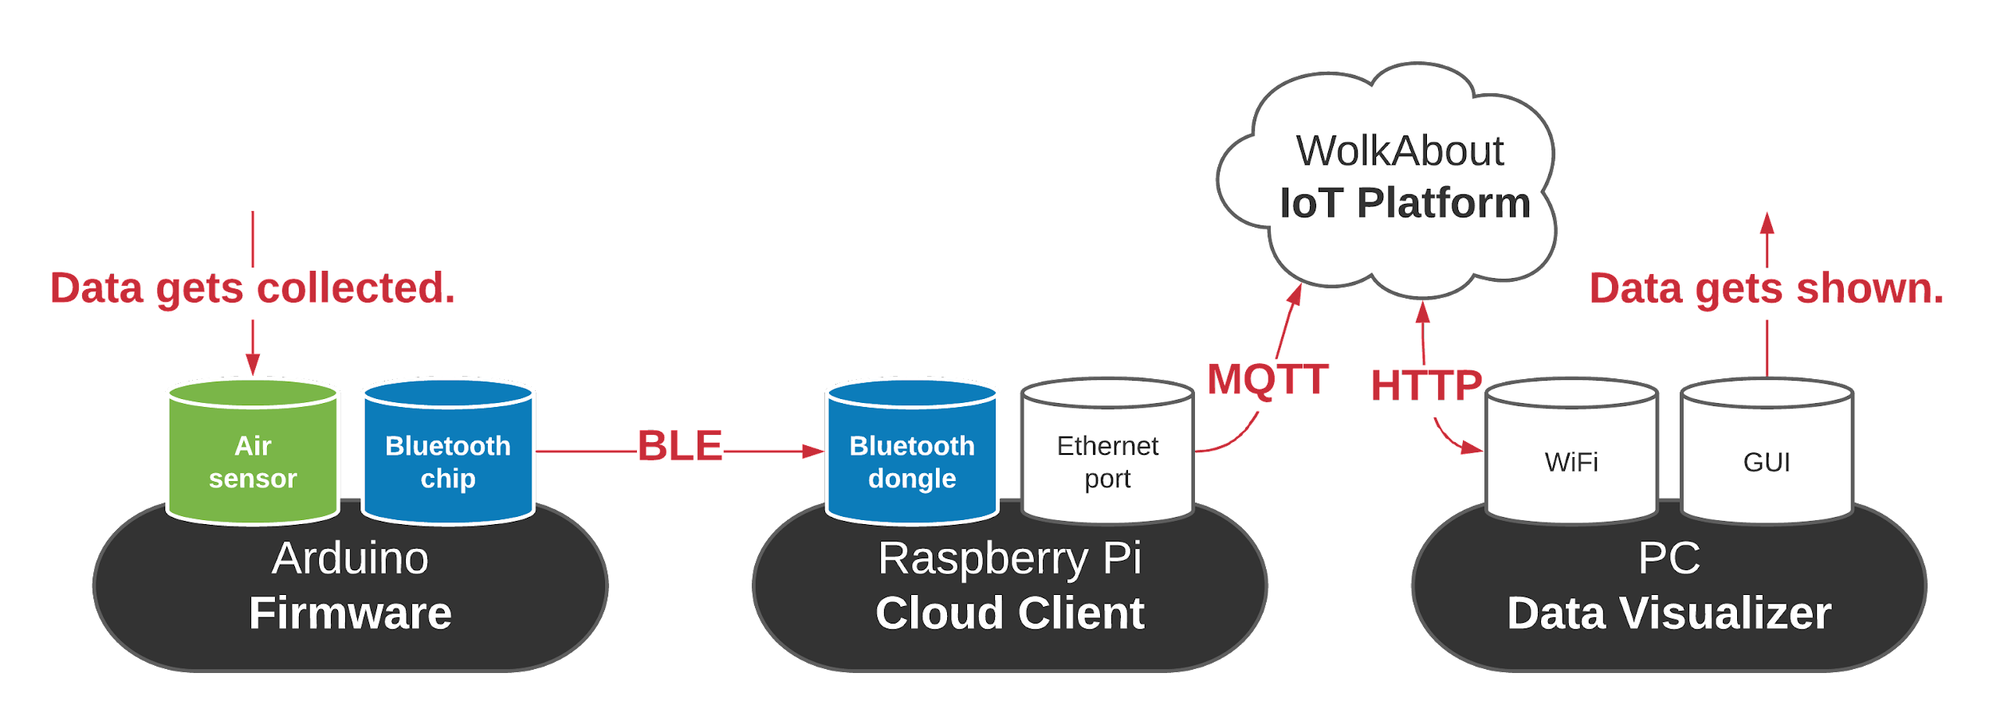
Project structure
Three distinct pieces of software - and how they are tied together

Slide 8
Arduino - Firmware

Slide 9
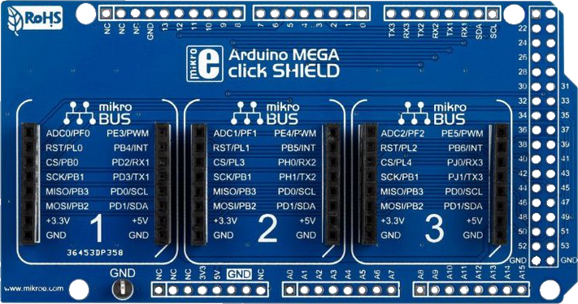
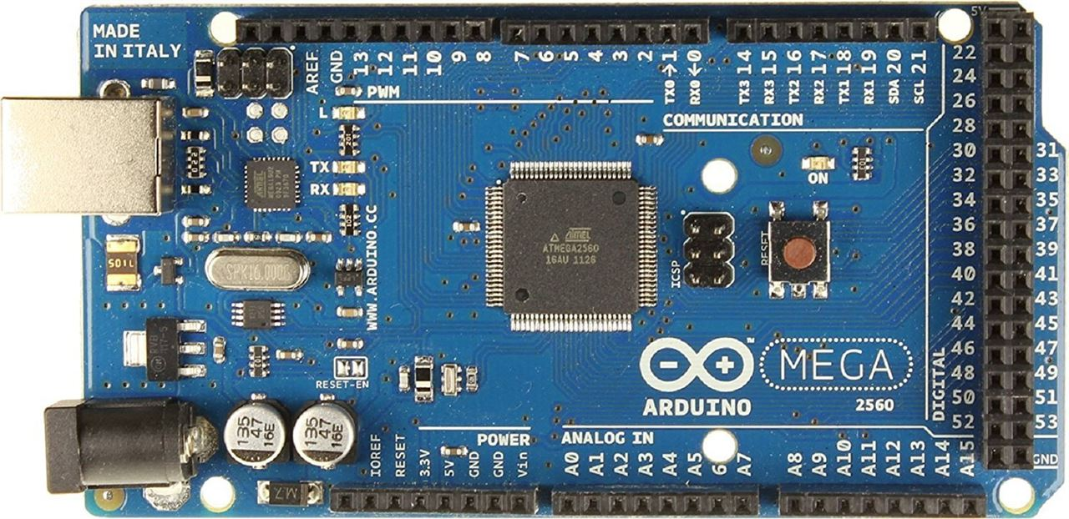
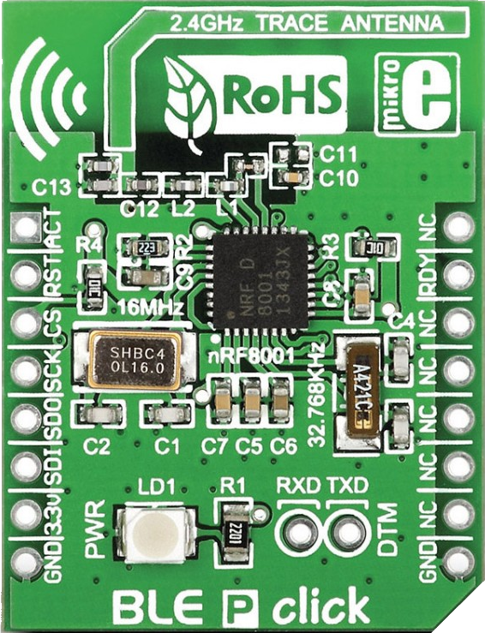
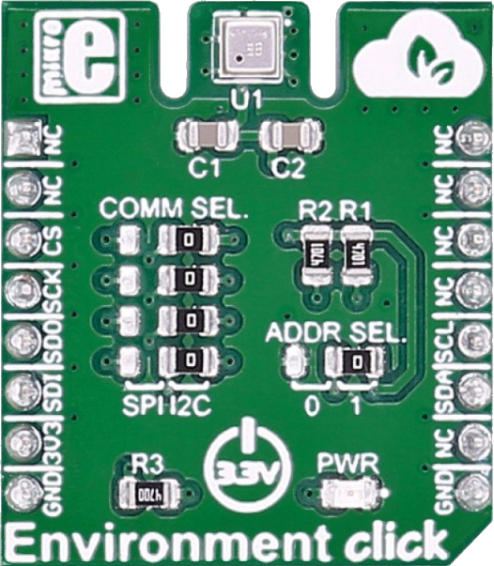
Arduino - the hardware
Key hardware components
Arduino Board
Click Shield
Environment Click
BLE Click

Slide 10
Arduino - the tools utilized
Access: From PC via Serial connection
Working environment: Arduino IDE
Programming language: C++
Libraries:
Adafruit - BME680 library
Sandeep Mistry - BLEPeripheral library

Slide 11
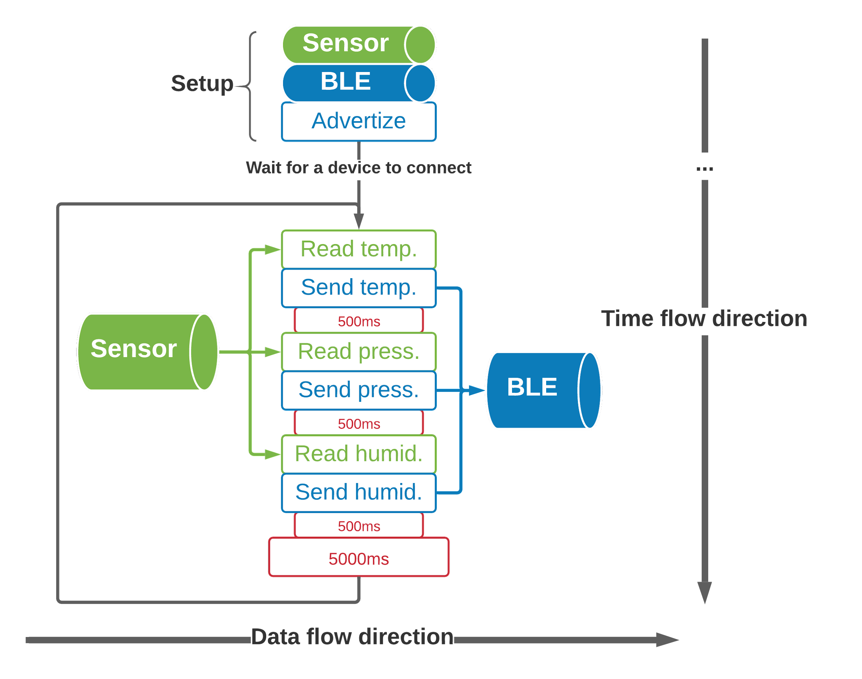
Arduino - the algorithm

Slide 12
Arduino - future
Which features could be added or improved upon
Make it possible for other types of clicks to collect data
Add LEDs which indicate current state of device
Add LCDs to print out the data
Advertize itself more clearly and descriptively
Add physical switches for different units of measurements

Slide 13
Raspberry Pi - Cloud Client

Slide 14
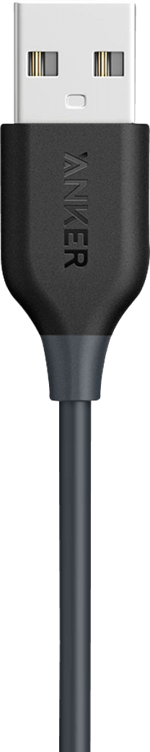
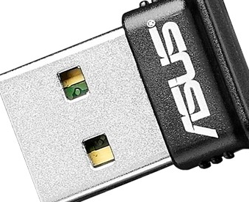
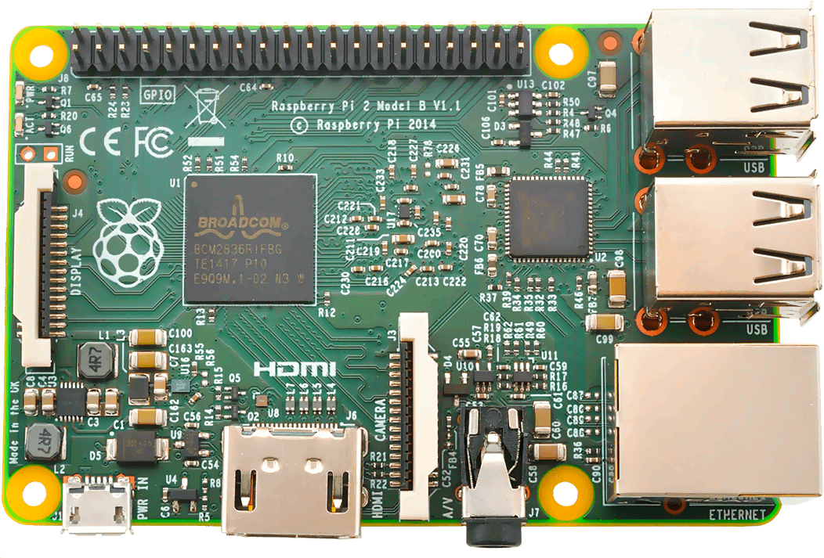
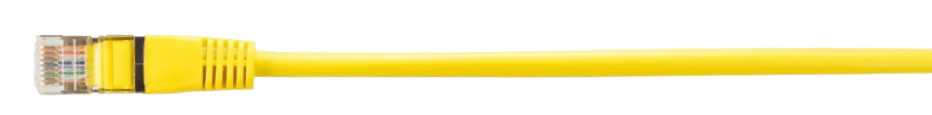
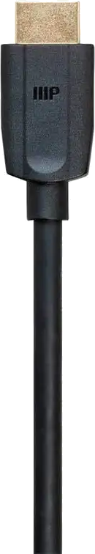
Raspberry Pi - the hardware
Key hardware components
Raspberry Pi 2 .
BLE Dongle .
Ethernet Cable .
Peripherals .

Slide 15
Raspberry Pi - the software
Tools utilized & algorithm in broad strokes
Access: Linux - Raspberry Pi OS (formerly Raspbian)
“Headless”, from PC via SSH
Working environment: Geany IDE
Programming language: C++
Libraries:
Psychogenic - Gattlibpp
WolkAbout - WolkConnect C++

Slide 16
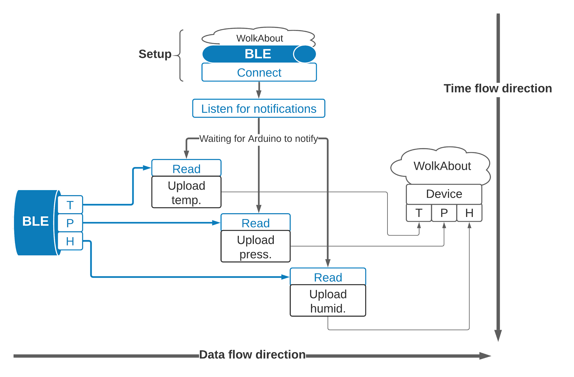
Raspberry Pi - the algorithm

Slide 17
Raspberry Pi - future
Which features could be added or improved upon
Access multiple devices (although not at once) and juggle all of them
Figure out the inconsistencies and random bugs with BLE
Expand from T, P, H into other types of data
Figure out type of data received on the spot, from a previously unconnected device
Connect to multiple Wolk virtual devices and juggle all of them

Slide 18
PC - GUI App

Slide 19
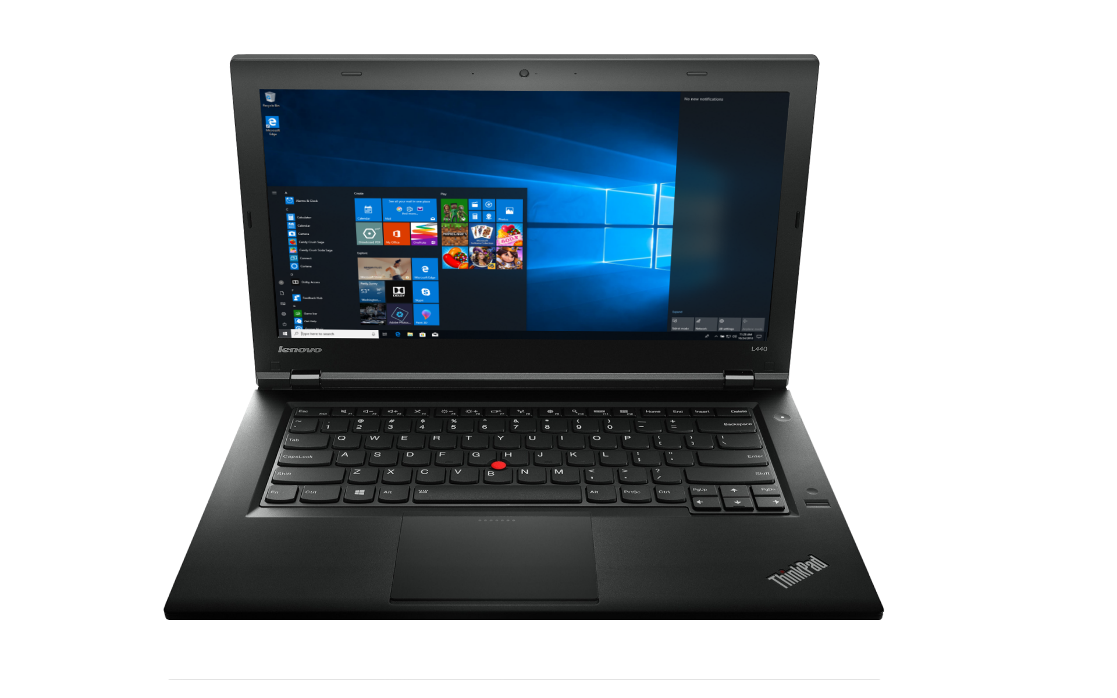
PC - Hardware
Key hardware components

Slide 20
GUI App - the software
Tools utilized
Access: Windows 10
Working environment: Qt Creator
Programming language: C++
Libraries:
Qt Company - Qt
cURL Project - libcurl

Slide 21
GUI App - the software
Qt’s strength - Expanding on the hardware
Qt offers the ability to build projects for all major platforms
Windows PC
Linux PC
Android
iOS
Vastly broadens the target market with little additions

Slide 22
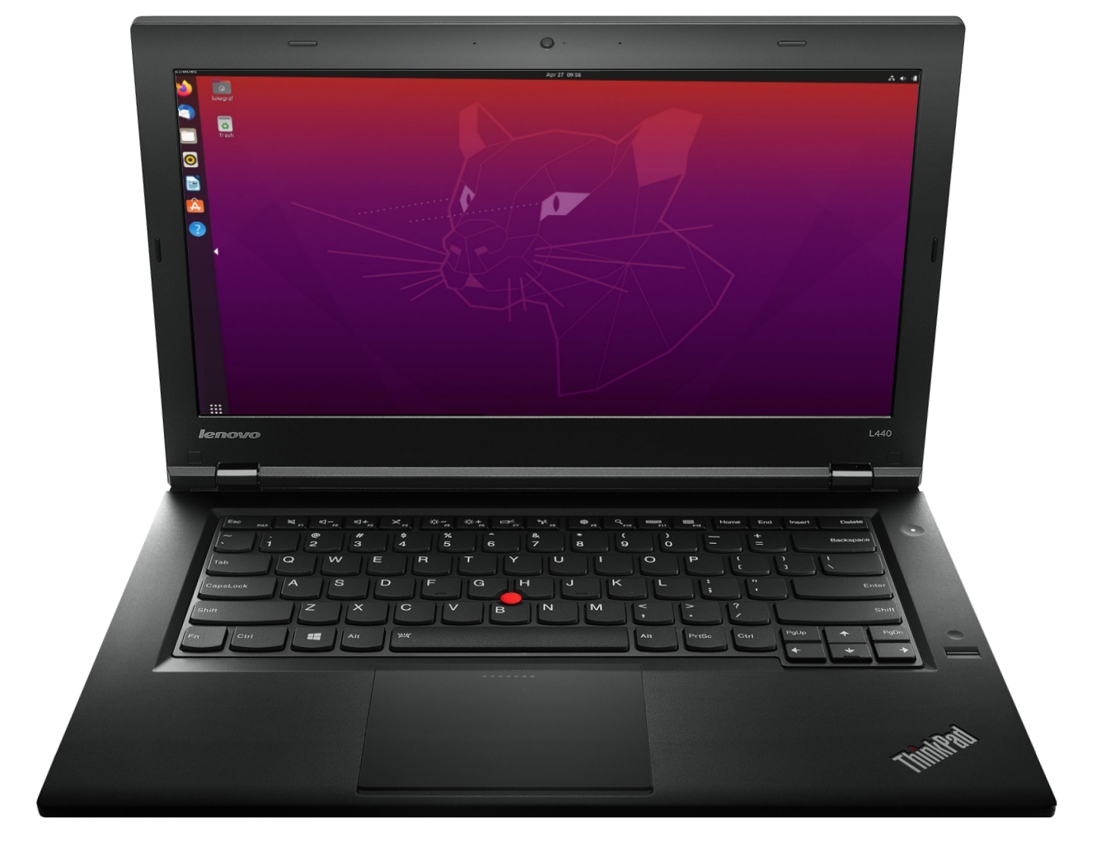
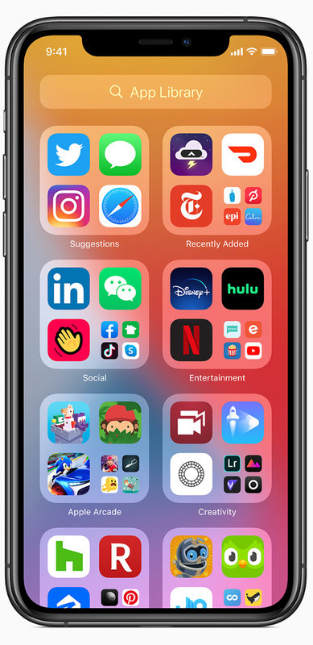
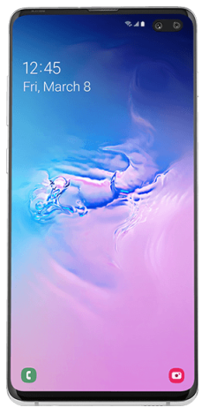
End user - Hardware
All major platforms

Slide 23
Qt App - the algorithm
It’s best to just see it in action during the demo.

Slide 24
End user platform - future
Which features could be added or improved upon
Build for all other major platforms, especially mobile ones
Add charts
Save charted data to files
Other types of data
Looking at multiple devices simultaneously
Separating each device with its data into own GUI unit
Add warnings/alarms for too high or too low values
Add additional intervals (apart from too low, ok, too high) for complexity
Add actuators, managing them
Being able to make and save multiple configurations (set of sensors, actuators and their mutual influences)

